Slide 1
Taxonomic Analysis
Niels W. Hanson
Bioinformatics Ph.D. Candidate
Tuesday, February 11 2014
Hallam Laboratory
Hydrocarbon MetaPathways Workshop
The University of British Columbia, Vancouver
https://github.com/nielshanson/mp_tutorial/wiki/Taxonomic-Analysis

Slide 2
Prerequisites
Python v2.x
Install MEGAN - http://ab.inf.uni-tuebingen.de/software/megan5/
Install R Studio - http://www.rstudio.com/
Downloads
Webpage:
https://github.com/nielshanson/mp_tutorial/wiki/Taxonomic-Analysis
Presentation Slides: MetaPathways_Tutorial_Taxonomic_Analysis.pdf
HOT MetaPathways Output: HOT_Sanger.zip
MetaPathways_to_megan scripts: metapathways_rRNA_to_megan.py metapathways_cog_to_megan.py metapathways_last_to_megan.py
Megan-Compatible Files: HOT_Sanger_megan_csvs.zip, HOT_Sanger_megan_dsvs.zip
Megan-Table File: HOT_megan_table.txt
Complete R Script: mp_tutorial_taxonomic_analysis.R

Slide 3
Tutorial Goals
Understand the basic background of the taxonomic signal related to the 16S rRNA, Clusters of Orthologous Genes (COGs), and MEGAN taxonomy.
Be able to prime taxonomic search results from MetaPathways for analysis in MEGAN via python scripts
Understand how to decline taxonomy in MEGAN and its ability to export samples
Outline some examples of downstream hierarchical clustering in the R statistical environment

Slide 4
1. Overview of Taxonomic Annotation
Ribosomal rRNA Genes
Clusters of Orthologous Genes (COGs)
RefSeq Functional Taxonomy (LCA or MEGAN-taxonomy)

Slide 5
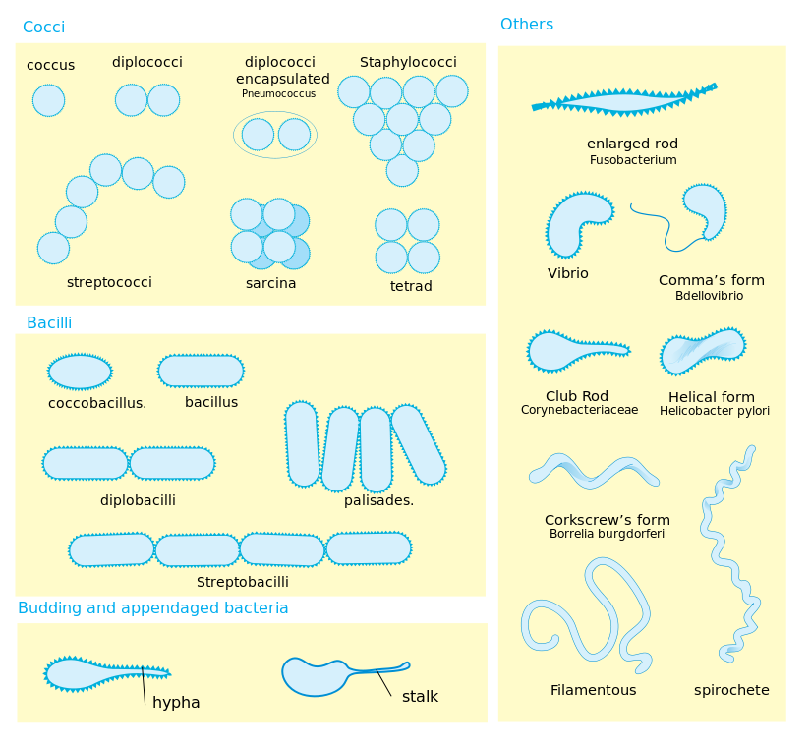
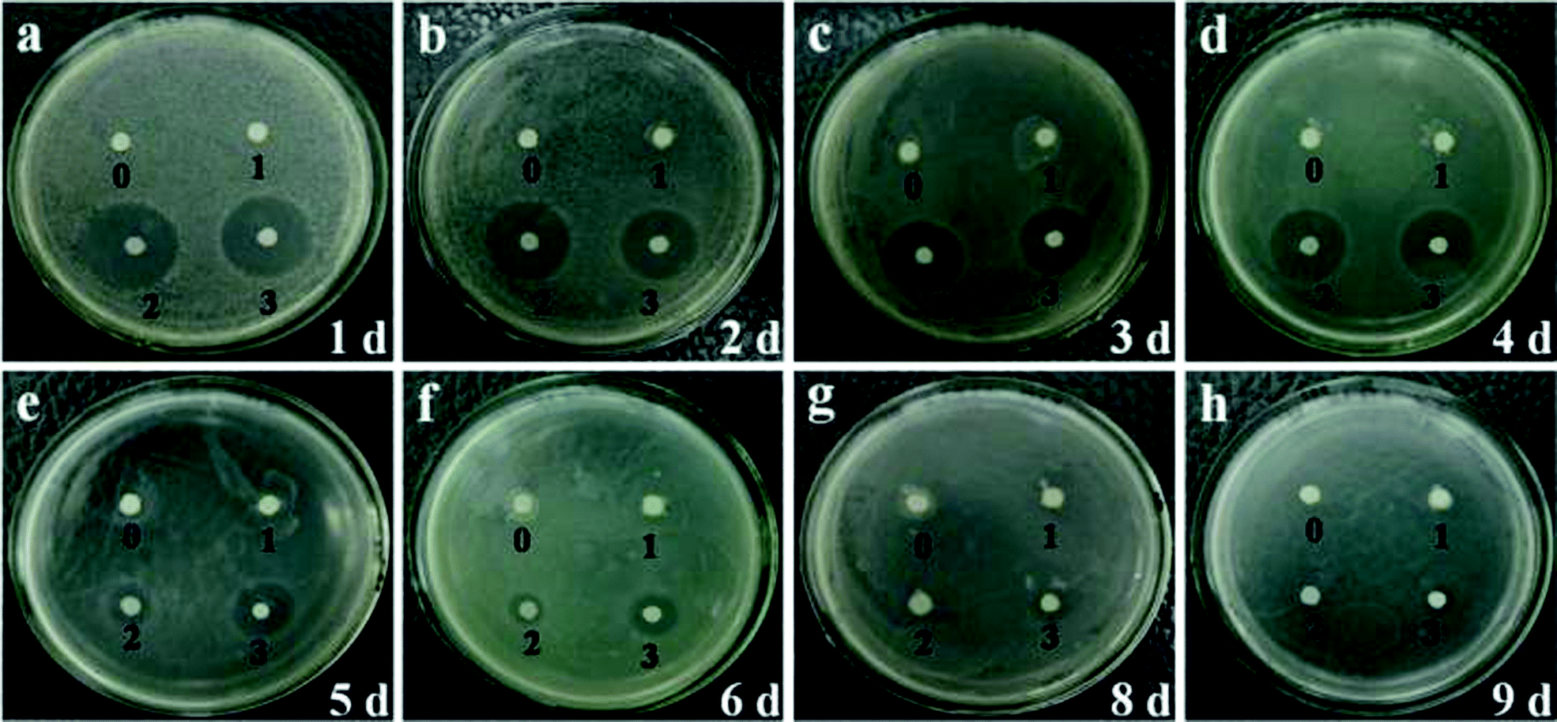
Ribosomal rRNA Genes (e.g., 16S, 18S)
Differences in morphology & growth of microbes insufficient to determine phylogeny — thought high order organisms has most diversity (Five Kingdoms Model)
Enter DNA sequencing: certain genes taxonomically relevant rRNA genes (widely found, stable sequence)
Alignment of hyper variable regions of 16S lead to development of modern ‘tree-of-life

Slide 6
Ribosomal rRNA Genes (e.g., 16S, 18S)
Ribosomal rRNA
Alignment
“Tree-of-Life”

Slide 7
Ribosomal rRNA Genes (e.g., 16S, 18S)
small (16S and 18S) and large (23S and 28S) rRNA subunits catalogued in databases (Silva¹, GreenGenes²)
Analysis i. 16S Amplified by PCR (a.k.a., pyrotags) - PCR Biases within & differences in ‘universal’ primers makes relative abundance of taxa “semi-quantitative” at best³ ii. Metagenomes - Not sequencing specifically - taxonomic breadth limited
- Possibly more quantitative – no ‘universal’ primer bias
E. Pruesse et al., SILVA: a comprehensive online resource for quality checked and aligned ribosomal RNA sequence data compatible with ARB, Nucleic Acids Research 35, 7188–7196 (2007).
T. Z. DeSantis et al., Greengenes, a chimera-checked 16S rRNA gene database and workbench compatible with ARB, Appl. Environ. Microbiol. 72, 5069–5072 (2006).
J. G. Caporaso et al., QIIME allows analysis of high-throughput community sequencing data, Nat Meth 7, 335–336 (2010).

Slide 8
Clusters of Orthologous Genes
What’s so special about the 16S rRNA gene? COG a collection of single copy genes for taxonomic signal¹
Triangle Homology Rule
“Any group of at least three proteins from distant genomes that are more similar to each other than they are to any other proteins are likely to form an orthologous set.”
R. L. Tatusov et al., The COG database: new developments in phylogenetic classification of proteins from complete genomes, Nucleic Acids Research 29, 22–28 (2001).

Slide 9

RefSeq Functional Taxonomy Metagenome Analyzer (MEGAN)
Genes identified in RefSeq have underlying genome of origin. - High quality hits possibly contain a (noisy) taxonomic signal
Megan an interactive software to implement the Lowest Common Ancestor (LCA) algorithm

Slide 10
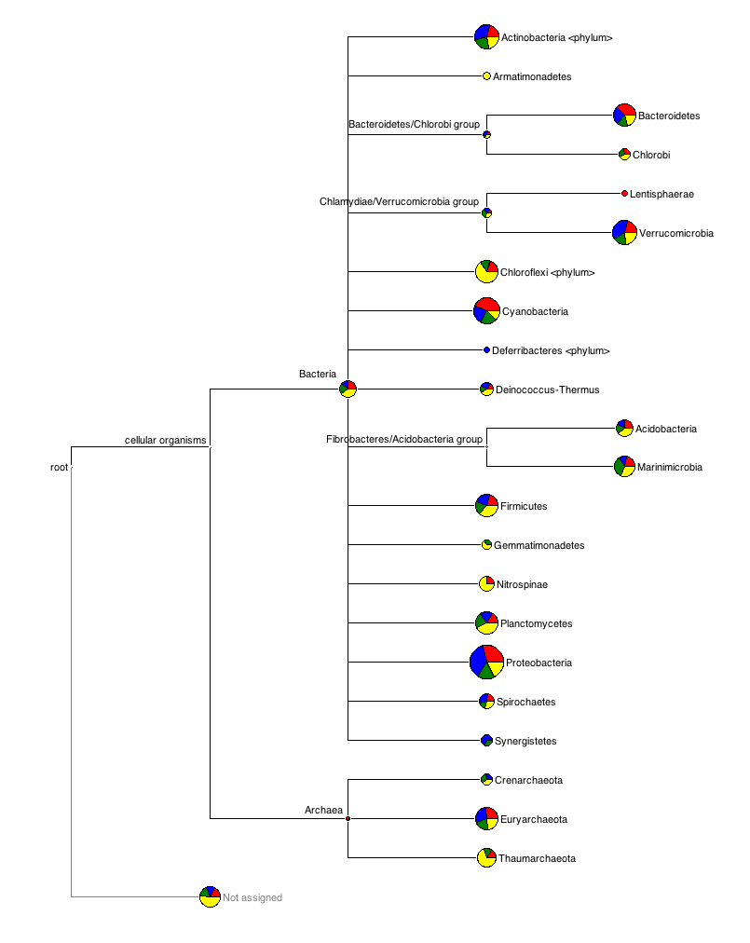
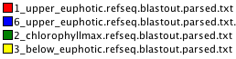
RefSeq Functional Taxonomy Metagenome Analyzer (MEGAN)

Slide 11
2. Priming MetaPathways output for MEGAN
Take rRNA (Silva, GreenGenes), RefSeq, and COG hits to MEGAN
MEGAN can easily parse comma-separated files (.csv) files in the following format: <read>, <taxa>, <score>
1_upper_euphotic_5292_1, Caulobacter vibrioides, 813
1_upper_euphotic_5292_1, Brucella melitensis, 786
1_upper_euphotic_5292_1, Pseudomonas aeruginosa, 774
1_upper_euphotic_5296_0, Mycobacterium tuberculosis CDC1551, 757
1_upper_euphotic_5296_0, Mycobacterium tuberculosis H37Rv, 757
1_upper_euphotic_5292_1, Salmonella typhimurium LT2, 743

Slide 12
Python Scripts: metapathways_[rRNA/last/COG]_to_megan.py
metapathways_rRNA_to_megan.py
$ python metapathways_rRNA_to_megan.py -i *.rRNA.stats.txt
-o output_folder .
[--dsv]
$ python metapathways_rRNA_to_megan.py -i HOT_Sanger/*/results/rRNA/*ssu*.rRNA.stats.txt -o .
metapathways_COG_to_megan.py
$ python metapathways_cog_to_megan.py -i *.cog.lastout.parsed.txt
-o output_folder .
[--dsv]
$ python metapathways_cog_to_megan.py -i HOT_Sanger/*/blast_results/*cog*parsed.txt -o .
metapathways_last_to_megan.py
$ python metapathways_last_to_megan.py -i *refseq.lastout.parsed.txt
-o output_folder .
[--dsv]
$ python metapathways_last_to_megan.py -i HOT_Sanger/*/blast_results/*refseq*parsed.txt -o .
Results: HOT_Sanger_megan.csv.zip, HOT_Sanger_megan_dsvs.zip

Slide 13
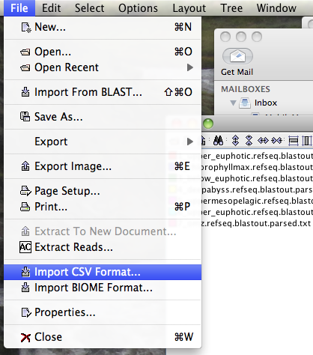
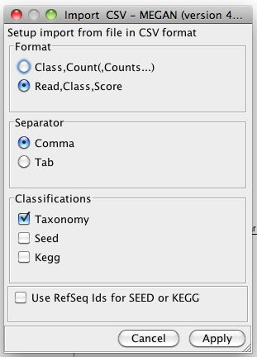
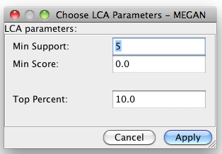
3. Loading Results into MEGAN
We will now load our .megan.csv.txt files into MEGAN
May want to change Min Support to 1 for rRNA

Slide 14
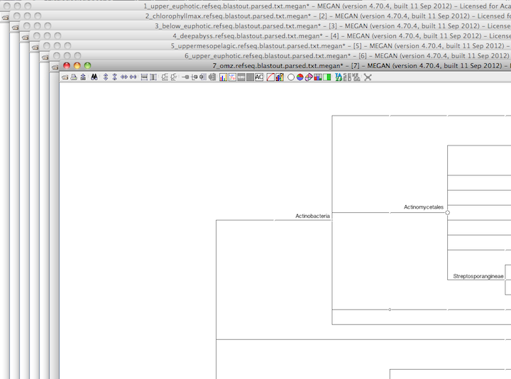
3. Loading Results into MEGAN
Repeat the process for all your samples

Slide 15
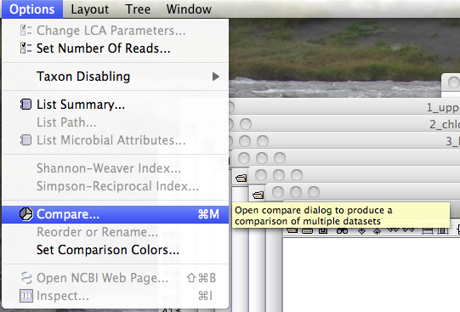
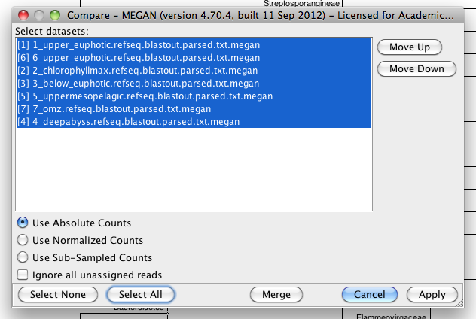
3. Loading Results into MEGAN
Options > Compare > Organize Samples

Slide 16
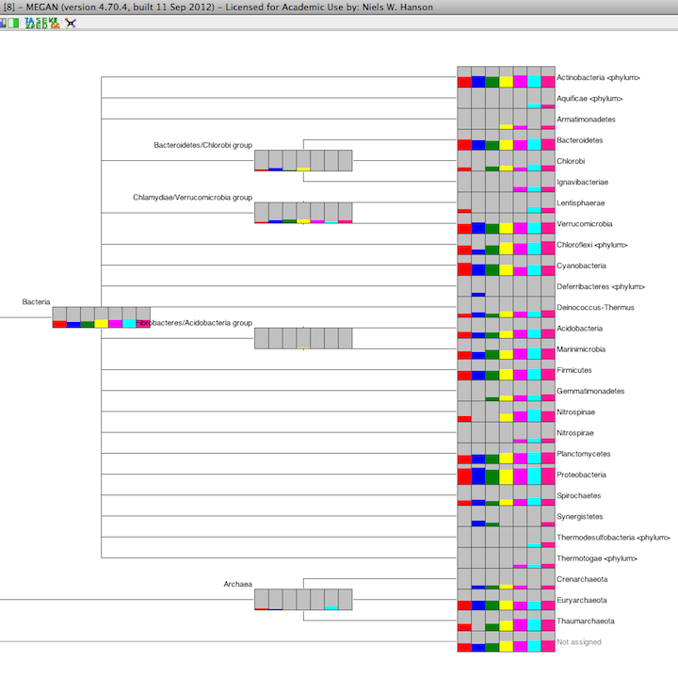
3. Loading Results into MEGAN
Repeat the process for all your samples

Slide 17
4. Export Taxonomy Results from MEGAN
Now are going to export the taxonomy hits from MEGAN in an R-compatible format
Decline your taxonomy hits to your preferred taxonomic level - this will really depend on your samples and biological goals
e.g., Tree > Collapse at Level or right-click options to un-collapse a given node (e.g., expand proteobacteria to the alpha-, beta-, gamma-, and delta- subgroups)

Slide 18
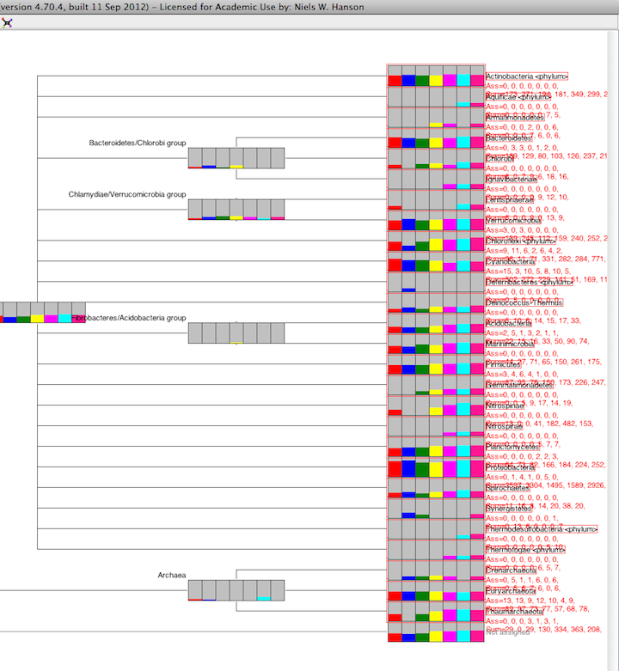
4. Export Taxonomy Results from MEGAN
Select desired taxonomy: e.g. Select > All Leaves

Slide 19
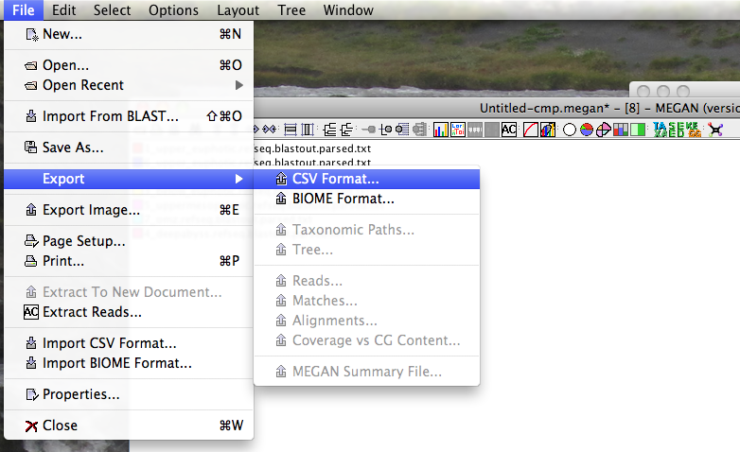
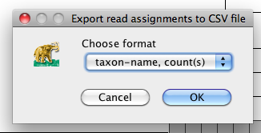
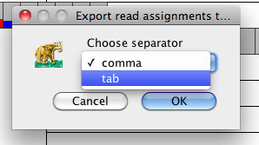
4. Export Taxonomy Results from MEGAN
Files > Export > CSV Format...
Tabs separator is nicer as commas can get used in Taxonomy Names

Slide 20
4. Export Taxonomy Results from MEGAN
So then we have our MEGAN Taxonomy Matrix: HOT_megan_table.txt
head HOT_megan_table.txt
#Datasets 1_upper_euphotic.refseq.blastout.parsed.txt 6_upper_euphotic.refseq.blastout.parsed.txt 2_chlorophyllmax.refseq.blastout.parsed.txt 3_below_euphotic.refseq.blastout.parsed.txt 5_uppermesopelagic.refseq.blastout.parsed.txt 7_omz.refseq.blastout.parsed.txt 4_deepabyss.refseq.blastout.parsed.txt
Actinobacteria <phylum> 173 271 194 181 349 299 252
Aquificae <phylum> 0 0 0 0 0 7 5
Armatimonadetes 0 0 0 7 6 0 6
Bacteroidetes 189 129 80 103 126 237 211
Chlorobi 6 0 7 9 6 18 16
Ignavibacteriae 0 0 0 0 9 12 10
Lentisphaerae 6 0 0 0 0 13 9
Verrucomicrobia 139 245 112 159 240 252 279
Chloroflexi <phylum> 96 11 71 331 282 284 771

Slide 21

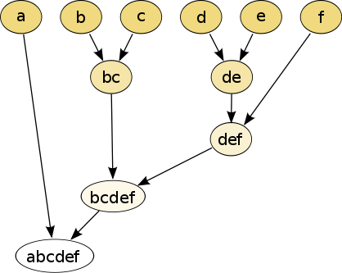
5. Hierarchical Clustering in R
Clustering – Methods to put objects into groups that are more similar within each other than between each other
Agglomerative – Bottom-up approach. Groups are built-up one at a time
Divisive – Top-down approach. Start with one big group and break it down.
Non-hierarchical
Hierarchical

Slide 22
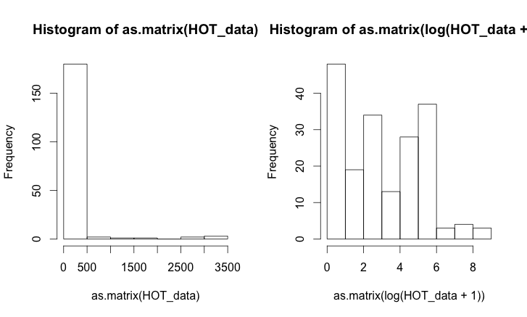
Data Scaling
Important to always plot your data to get an idea of relative data ranges

Slide 23
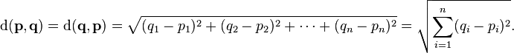
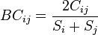
Distance Metrics: Euclidian & Bray-Curtis
Distance Metric to compare samples. Samples are treated as point in a multi-dimensional taxa space.
Euclidian distance
Bray-Curtis Dissimilarity – Set comparison between shared species over observed species
Avoids the double zero problem by only looking at observed taxa

Slide 24
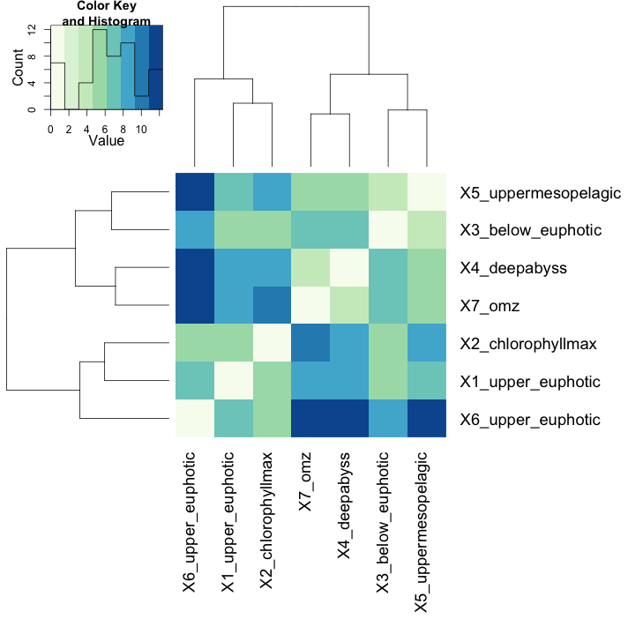
heatmap2()
setwd("~/Desktop/")
HOT_data <- read.table("HOT_megan_table.txt", header=TRUE, sep="\t", row.names=1)
HOT_data <- log(HOT_data + 1) # transpose
HOT_data.t <- t(HOT_data) # transpose HOT_data
HOT_data.t.dist <- dist(HOT_data.t) # calculate the euclidian distance between the rows
HOT_data.euclid.fit <- hclust(HOT_data.t.dist)
library("gplots")
library("RColorBrewer") # for colours
euclid_dend <- as.dendrogram(HOT_data.euclid.fit) # get ordering for heatmap
my_colours <- brewer.pal(8,"GnBu") # my colours
heatmap.2(as.matrix(HOT_data.t.dist), margin=c(14,14),
Rowv=euclid_dend,
Colv=euclid_dend,
col=my_colours,
trace="none",
denscol="black")

Slide 25
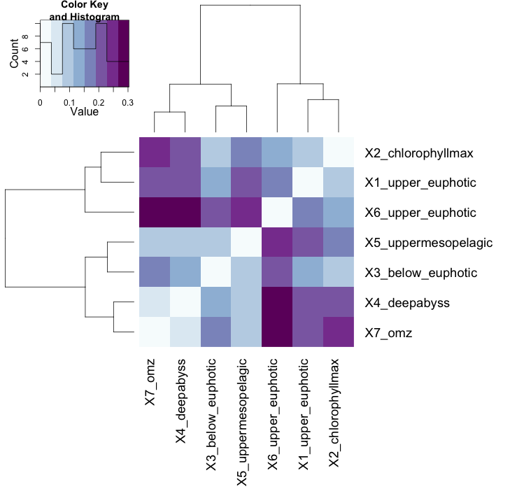
heatmap2() with multiple distance metrics
try(library("ecodist"), install.packages("ecodist")) # try load, otherwise install
library("ecodist") # try to load again
HOT_data.t.bcdist <- bcdist(HOT_data.t)
HOT_data.bcdist.ward.fit <- hclust(HOT_data.t.bcdist, method="ward")
bc_dend <- as.dendrogram(HOT_data.bcdist.ward.fit) # get ordering for heatmap
my_bc_colours <- brewer.pal(8,"BuPu") # my colours
heatmap.2(as.matrix(HOT_data.t.bcdist), margin=c(14,14), Rowv=bc_dend, Colv=bc_dend,
col=my_bc_colours, trace="none", denscol="black")

Slide 26
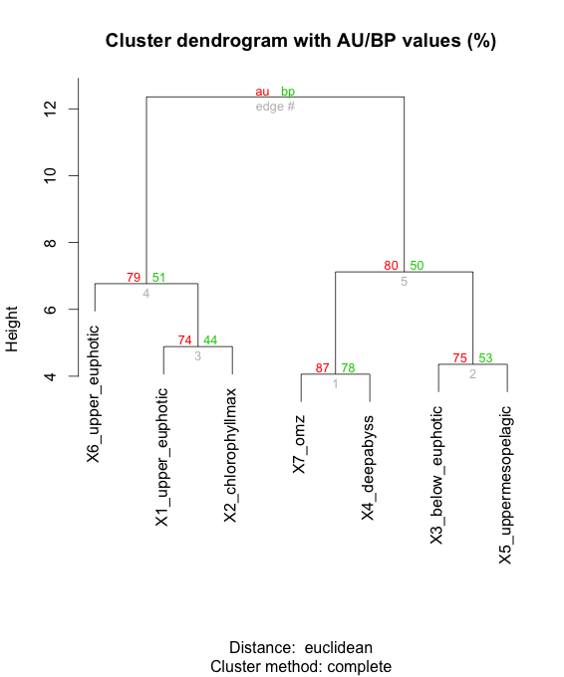
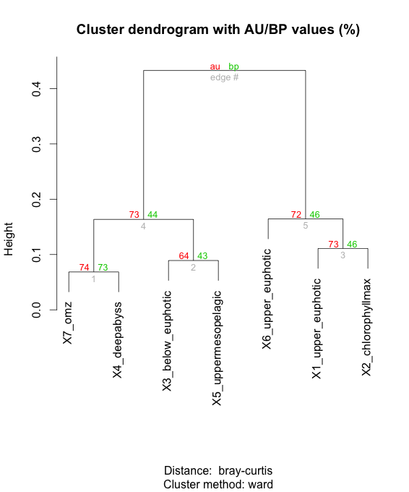
Assessing significance: bootstrapping p
library(pvclust)
HOT_data.pv_fit <- pvclust(HOT_data,
method.hclust="complete",
method.dist="euclidian", n=1000) # in this case no transform is need
plot(HOT_data.pv_fit)
library("devtools") # used to source functions from the internet
source_url('http://raw.github.com/nielshanson/mp_tutorial/master/taxonomic_analysis/code/pvclust_bcdist.R')
HOT_data.bcdist.pv_fit <- pvclust(HOT_data, method.hclust="ward", method.dist="bray–curtis", n=1000)
plot(HOT_data.bcdist.pv_fit)

Slide 27
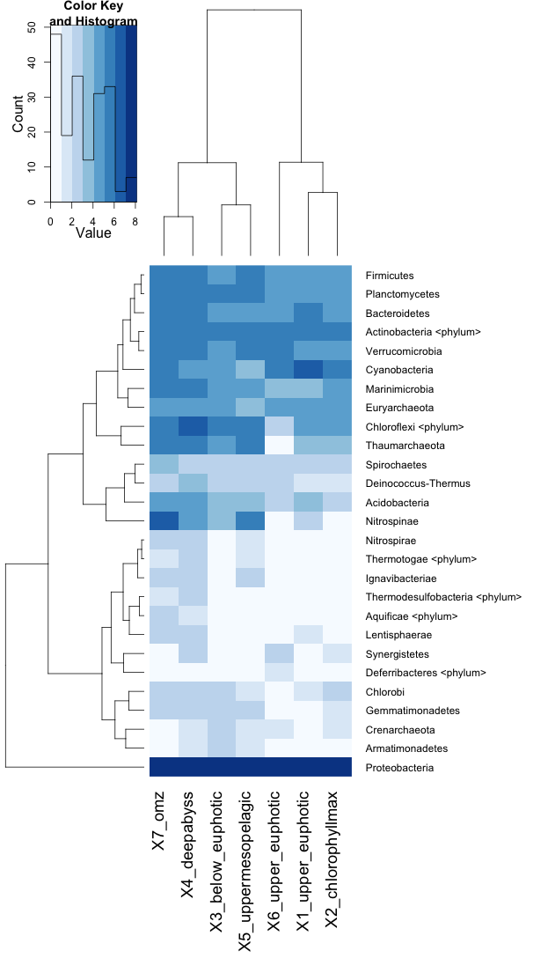
Visualizing Clustering on Taxa Profile
my_colours <- brewer.pal(8,"Blues") # another colour scheme
HOT_heat <- heatmap.2(as.matrix(HOT_data),
margin=c(14,14),
col=my_colours,
Colv=bc_dend,
trace="none",
denscol="black")

Slide 28
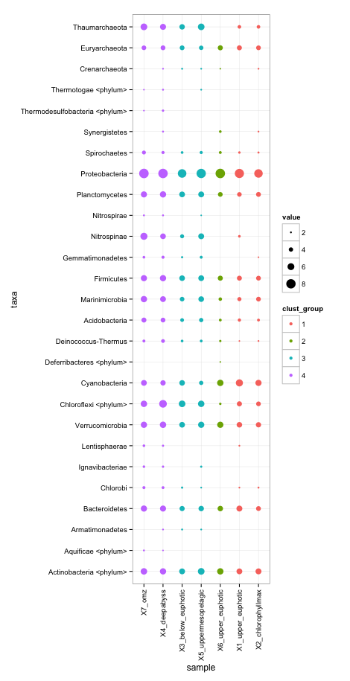
ggplot()

Slide 29
ggplot()
library(ggplot2)
library(reshape2) # transform our Data from wide to long format
HOT_data$taxa = rownames(HOT_data) # add taxa from rownames to Data Frame
HOT_data.m <- melt(HOT_data)
colnames(HOT_data.m)[2] = "sample" # rename variable column to sample
# in order to plot things in properly, the order of each variable has to be explicitly set
name_order <- HOT_data.bcdist.ward.fit$labels[HOT_data.bcdist.ward.fit$order] # get order of samples from clustering
HOT_data.m$sample <- factor(HOT_data.m$sample, levels=name_order) # set order of samples
HOT_data.m$taxa <- factor(HOT_data.m$taxa, levels=unique(HOT_data.m$taxa)) # set order of taxa
# cut bray-curtis clustering to get groups
bc_ward_groups <- cutree(HOT_data.bcdist.ward.fit, h=0.12) # slice dendrogram for groups (hight=0.2)
HOT_data.m$clust_group <- as.vector(bc_ward_groups[as.vector(HOT_data.m[,"sample"])])
HOT_data.m$clust_group <- as.factor(HOT_data.m$clust_group) # set group numbers as factors
# finally create the bubble plot
g <- ggplot(subset(HOT_data.m, value >0), aes(x=sample, y=taxa, color=clust_group))
g <- g + geom_point(aes(size=value)) # plot the points and scale them to value
g <- g + theme_bw() # use a white background
g <- g + theme(axis.text.x = element_text(angle = 90, vjust = 0.5, hjust = 1)) # rotate and centre labels
g # plot it, whew!

Slide 30
Questions?

